Slide 1
Fair Trading & Cartels Update
Customs Brokers & Freight Forwarders Association
Yvette Popovic & Grant Chamberlain – September 2022

Slide 2
What we will cover today
Commerce Commission – our role and responsibilities
Fair Trading Act – new changes in 2022
Commerce Act – cartel conduct
Q&A

Slide 3
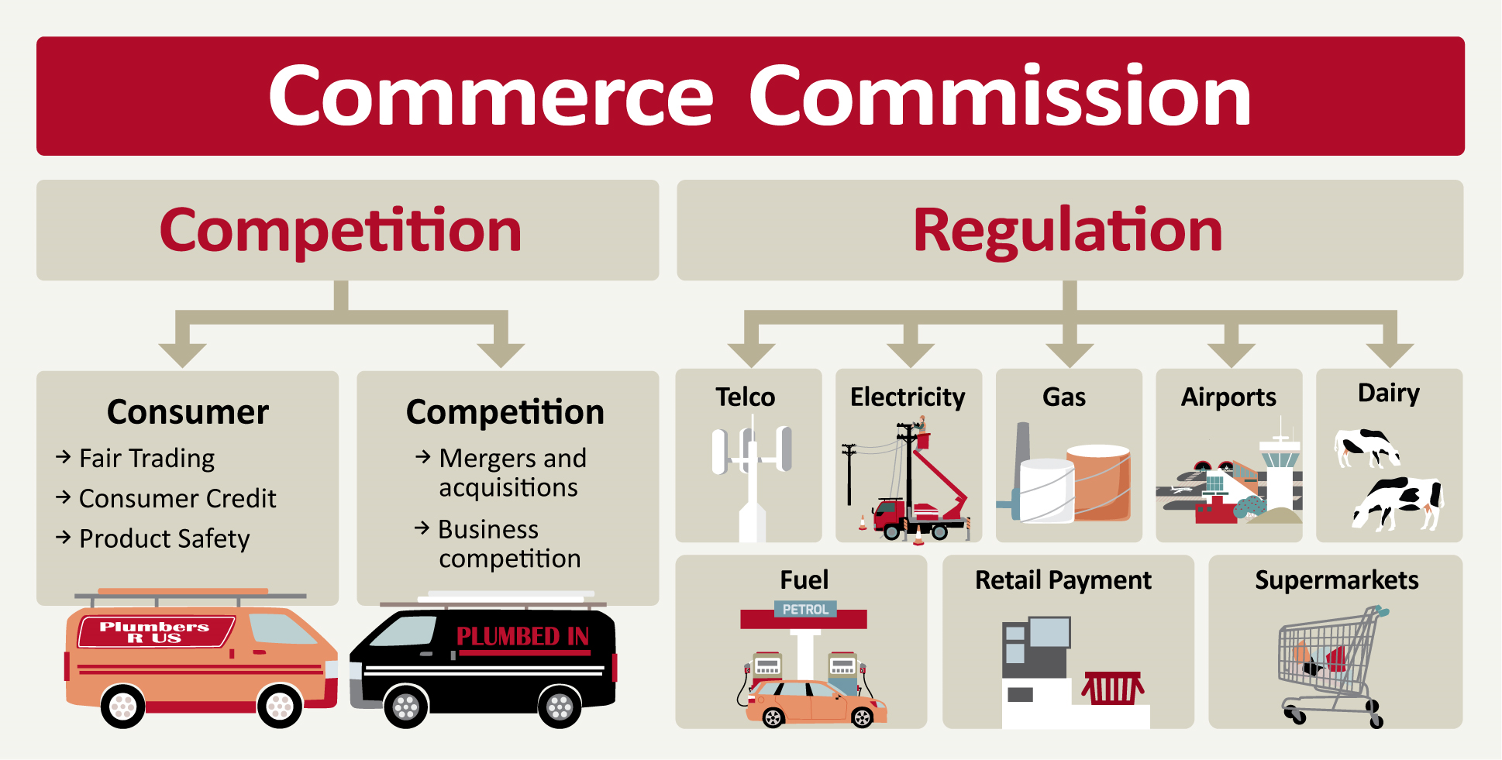
Who are we?

Slide 4
The Commerce Commission
We are New Zealand’s primary competition, fair trading and consumer credit, and economic regulatory agency.
We play a crucial role in ensuring New Zealand’s markets are competitive, consumers are well informed and protected, and sectors with little or no competition are appropriately regulated.

Slide 5
Our responsibilities
We are responsible for enforcing laws relating to competition, fair trading and consumer credit contracts. We also have regulatory responsibilities in the electricity lines, gas pipelines, telecommunications, dairy, airport, and fuel sectors.
Our powers, functions and duties come under various Acts including:
Commerce Act
Fair Trading Act
Telecommunications Act
Credit Contracts and Consumer Finance Act
Dairy Industry Restructuring Act
Fuel Industry Act
Retail Payment System Act

Slide 6
Our contribution to New Zealanders
Our vision is that New Zealanders are better off when markets work well, and consumers and businesses are confident market participants.
The three main areas of work that the Commission undertakes in collaboration with many other parts of the public sector are:
Promoting competition in markets throughout the economy
Influencing monopoly infrastructure performance for better essential services
Tackling harm, including from unfair trade practices and irresponsible lending.
Our strategies are to:
Seize opportunities to have the greatest impact
Protect, inform and empower consumers and businesses
Be trusted, influential and high-performing

Slide 7
Fair Trading Act - overview
Protects against
Misleading and deceptive conduct
False or misleading representations
Unsubstantiated claims
Unfair trading practices
To enable consumers to make informed choices about the goods and services they buy
To ensure fair competition

Slide 8
Changes to the Fair Trading Act
Important new provisions come into force on 16 August 2022
Unconscionable conduct in trade prohibited
Unfair contract terms (UCTS) extended to standard form small trade contracts that exceed annual value threshold of $250,000 including GST when the trading relationship first arises.
Uninvited direct sales – “Direction to leave” provisions - giving some teeth to “do not knock” stickers/notices

Slide 9
UCT provisions
Must be consumer/small trade contract
Contract must be standard form
Term is unfair if it:
Causes significant imbalance; and
Is not reasonably necessary; and
Would cause detriment if applied.
Grey list
Consider contract as a whole & transparency
Exempt terms
Declaration

Slide 10
What is a small trade contract?
Both parties engaged in trade
Not a consumer contract
Doesn’t comprise or form part of a trading relationship that exceeds an annual value threshold of $250,000 (inc GST) when the trading relationship first arises
If party claims it’s a small trade contract, presumed to be until proven otherwise.

Slide 11
What is a trading relationship?
Consists of:
The contract; and
Any other contract (whether current or prospective) between the same parties on the same or substantially similar terms
Main subject matter & upfront price of contract don’t impact whether contracts are substantially similar
Assessed when the relationship first arises (after 16 August 2022)

Slide 12
How do you assess the annual value threshold?
The relationship exceeds the threshold when:
>$250K is payable under it in any annual period for goods/services/interest in land; or
>$250K is more likely than not to become payable in any annual period for goods/services/interest in land.
In any annual period

Slide 13
Statutory example #1
A + B – first contract on 1 December 2022.
A to pay B $253K before 1 December 2023
On 1 November 2023, A + B form new contract on same terms for $57,500 for services in 2024.
Are these small trade contracts?

Slide 14
Answer to statutory example #1
NO. Neither contract is a small trade contract. Annual value threshold exceeded when relationship first arises.

Slide 15
Statutory example #2
A + B have two contracts for fruit purchase. Same terms.
Contract 1 – $120,000 per year for grapes, entered 1 January 2023.
When A + B sign Contract 1, they know that they were going to enter into Contract 2.
Contract 2 – $180,000 per year for apples, entered 1 January 2024.
Are these small trade contracts?

Slide 16
Answer to statutory example #2
NO. Neither contract is a small trade contract. Part of same trading relationship, and annual value threshold exceeded when relationship first arises.

Slide 17
Statutory example #3
A + B enter open-ended contract for stationery on 1 May 2024.
Contract doesn’t specify price, but parties expect that B will pay A $100,000 each year.
After 3 years, B is buying $300,000 of stationery each year.
Is this a small trade contract?

Slide 18
Answer to statutory example #3
YES. This is a small trade contract because annual value threshold not exceeded when the relationship first arises.

Slide 19
ACCC examples
Mitolo – potato farming
Servcorp – office space supply contracts
JJ Richards – waste management

Slide 20
Unconscionable conduct
Section 7
A person must not, in trade, engage in conduct that is unconscionable
This section applies whether or not –
there is a system or pattern of unconscionable conduct; or
a particular individual is identified as disadvantaged, or likely to be disadvantaged, by the conduct; or
a contract is entered into
This section is not limited by any rule of law or equity relating to unconscionable conduct.

Slide 21
Section 8 – Court may have regard to certain matters
Relative strengths of bargaining positions
Extent to which parties acted in good faith
Traders using undue pressure or influence, or unfair tactics
If an affected person was able to understand the documents
If the trader unreasonably failed to disclose intended adverse conduct, and risks
If an affected person, or their representative, was reasonably able to protect their interest
Any other relevant circumstances

Slide 22
Unconscionable conduct
Coming into effect 16 August 2022
Does not apply to retrospective conduct
Usual FTA penalty regime
$600K for business, $200K for individual
Civil remedies: refunds; damages; injunctions; terms altered/declared void

Slide 23
Examples from Australia
ACCC v Lux Distributors Pty Limited [2013] FCAFC 90
Door to door sales of expensive vacuum cleaners- up to $2280
Five elderly women telephoned (scripts) / visited by Lux rep under premise of 'free' maintenance check – Three of women aged 82, 89 and 93
Court found:
Women subjected to unfair and pressure selling techniques – lengthy visits – over an hour and half
A ruse was used to gain entry
to create need for replacement machine -primary purpose to sell vacuum cleaner
Failed to comply with State laws re disclosure requirements

Slide 24
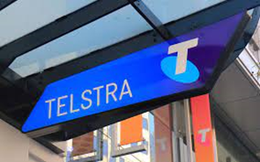
ACCC v Telstra Corp Limited [2021] FCA 502 - $50m penalty
Five Telstra licensed dealers in remote areas across 3 states/ territories
Signed up 108 indigenous consumers to pay monthly mobile plans:
without properly explaining the contractual terms,
the nature and cost of mobile plans,
the minimum liability that the customers would have or
to check if customers could reasonably afford the plans before signing them up.
Customers often did not speak English as a first, second or even third language
Staff told customers product "free' / manipulated credit assessments e.g., noted employed when not etc

Slide 25
Business to Business
ACCC v Coles Supermarkets Australia Pty Ltd [2014] FCA 1405
Two sets of proceedings issued relating to its Active Retail Collaboration programme (ARC) - settled with agreed penalties
Misconduct serious, deliberate and repeated
Misused bargaining power
Conduct not done in good conscience = treated suppliers in a manner not consistent with acceptable or social standards which apply to commercial dealings
Demanded payments from suppliers to which it was not entitled by threatening commercial harm to suppliers which did not comply
Withheld money from suppliers it had no right to withhold

Slide 26
How to stay off our radar
Identify compliance challenges in your business
Put in place good compliance processes
Have good complaints handling processes to reduce complaints to the Commission
Pay heed to compliance advice and warning letters

Slide 27
Commission cartel priorities
Priorities 2022/23
Our vision is to make New Zealanders better off
Focus areas cartels
Educating businesses/traders about conduct that may contravene cartel laws.
Taking enforcement action where appropriate

Slide 28
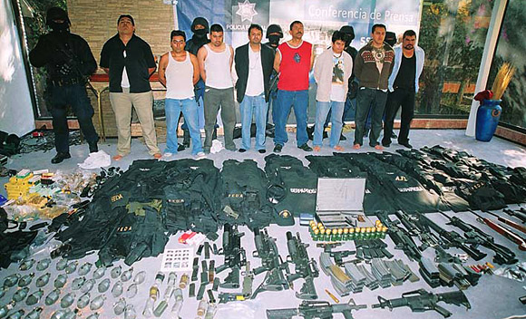
What is a cartel?
It’s not what some traders may think…

Slide 29
Competitors
Competitors are businesses who do, or could, offer the same or similar goods and services to your customers
Includes buying markets
Includes potential competitors - eg a business who could choose to enter the market you are operating in
Who is or who could be a competitor may be wider than businesses/traders think

Slide 30
The cartel prohibition – section 30
Commerce Act
Prohibition on competitors entering into a contract or arrangement, or arrive at an understanding containing or giving effect to cartel provision (also attempts and conspiracy)
Price-fixing agreements (including bid rigging)
Market allocation agreements
Output restriction agreements
Low threshold to reach an agreement

Slide 31
Why we care – cartels are harmful
Affects Competition
Affects Consumers
Affects business
Economic theft
Often deliberate, covert
& deceptive
Decreases quality
Raises prices/decreases consumption
Decreases incentives
Harms markets
Decreases choice
Harms competitive process
Decreases innovation

Slide 32
Outcomes and civil penalties
We investigate and this can include using compulsory powers
After investigating we decide from a range of outcomes
If a breach and court action results - penalties are significant
Up to $10m per breach for companies and $500k individuals
Potential private action by affected parties
Also:
negative publicity may result
individuals can be banned from being directors or managers

Slide 33
Case examples
Air Cargo cartel $42m total penalties and one airline $7.5m penalty
Freight Forwarders cartel $12m total penalties
Real Estate cartel almost $21m in penalties
Ronovations property (buying) cartel $400k in penalties
Nelson pharmacies $394k in penalties
Freight forwarders (2022) $9.7m in penalties
Many of these cases involved industry groups / associations, and in several cases input cost increases

Slide 34
Criminal outcomes also possible
What is criminalisation?
Cartel prohibitions are the same but criminal sanctions also apply
Negative publicity and banning can still result
What are the criminal penalties?
Up to 7 years imprisonment for individuals or penalty up to $500k or both ( Category 3 offence)
Fines same as civil penalties for businesses
Commission also has criminal investigation powers including interception warrants

Slide 35
Defences and exceptions
Some agreements are fully exempt from Part 2 of the Commerce Act and some are exempt only from the cartel provisions of section 30:
Sections 43-45 for general exemptions
Sections 31-33 for cartel exceptions.
Cartel exceptions, eg, collaborative activities, vertical supply contracts and joint buying and promotion agreements.
Criminal Defence – Reasonable belief that any defences apply
Authorisation of agreements by CC also possible

Slide 36
Collaborative activities
These can occur when :
Businesses carry on an enterprise, venture, or other activity, in trade in cooperation
There is a cartel provision in the agreement which is reasonably necessary; and
The main reason for the activity is not to lessen competition.
Commission has extensive guidelines available
Purpose is important - be very careful
Legal advice is recommended

Slide 37
Areas to watch?
Areas of regular interactions with competitors
Individuals who have gone to work at a competitor – continue social/work relationships
Care needed in and around industry associations
Subcontracting – stick to the subcontracting agreement only
Supplying a competitor a key input service - eg landfill services
Regulatory costs – businesses still need to independently choose to pass them on
Environmental – Commerce Act still applies and agreement involving competitors likely needs to be assessed/authorised

Slide 38
Avoiding cartels - what can you do?
Increase knowledge of Commerce Act and boundaries, undertake regular training
Rules for interacting with competitors and keep minutes etc - managers recognise any cartel red flags
Make pricing / market decisions independently of competitors
Whenever not sure, seek legal advice promptly
An enduring compliance programme is wise snf
Get early legal advice before discussing any proposed collaborative activities/agreements with competitors
If a problem is found there are options – seek advice and act very quickly

Slide 39
What to do if aware/involved?
Report it – why do that?
Can get full immunity if first in – including criminal
If not involved but aware of it – tell us directly or use the AWB system on our website – we never know who is reporting it but you can tell us about it.
https://comcom.govt.nz/business/avoiding-anti-competitive-behaviour/what-is-a-cartel/reporting-cartel-conduct

Slide 40
Questions?

Slide 41
Contact details
Grant Chamberlain
Cartels Manager
Grant.Chamberlain@comcom.govt.nz
04 924 3828

Slide 42
ComCom Cartel resources
Via: https://comcom.govt.nz/business/avoiding-anti-competitive-behaviour/what-is-a-cartel
Also see: https://comcom.govt.nz/__data/assets/pdf_file/0036/89856/Competitor-Collaboration-guidelines.pdf
https://comcom.govt.nz/__data/assets/pdf_file/0023/256406/Exceptions-under-the-Commerce-Act-Fact-sheet-June-2021.pdf

