Slide 1
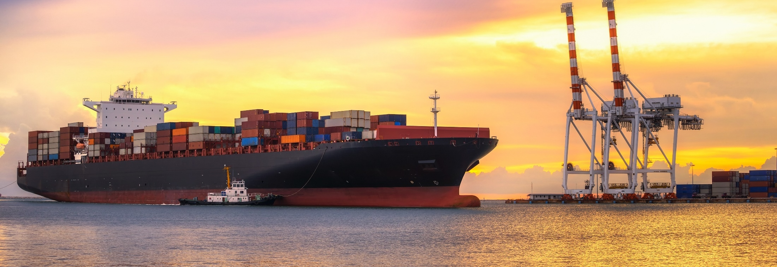


DTR Sea Freight Project
CBAFF Conference – 23 Sep 2022

Slide 2
Introduction
Dunja Hassencamp | Manager, Intelligence, Targeting & Evaluation (MPI)
Peter Lewis | Manager, Service Delivery (Customs)
Craig Chitty | Group Manager, Revenue & Assurance (Customs)

Slide 3
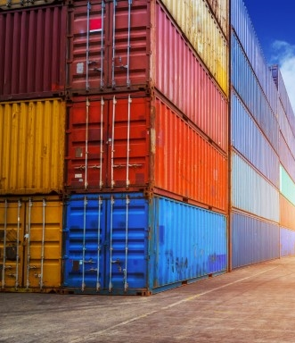
Agenda
What is DTR Sea?
Why change and what are the benefits of DTR Sea?
Project Plan
How you can engage with DTR Sea
Next steps
Questions

Slide 4
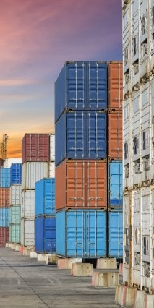
Background
Domestic Transhipment Requests (DTR) was built as part of Trade Single Window (TSW) and completes the ICR functionality when implemented as per original design
DTR was built to allow the movement of uncleared goods
DTR Air was piloted and mandated on 1st July 2022
Lessons learnt from DTR Air

Slide 5
What is DTR Sea?
A Domestic Transhipment Request (DTR) is a request to move uncleared cargo from one approved facility to another approved facility.
  This is required for any point-to-point movement
  An approved facility must be both a CCA and a Transitional Facility
DTRs are requested through Trade Single Window (TSW) on an Inward Cargo Report (ICR). Like other TSW messages, DTRs can be approved, declined, or held.
DTRs intent is to replace the current manual approval systems for domestic transhipments i.e.:
  Customs ‘Continuing Collectors Permit’ and hard copy ‘Permit to Remove’ for movement in NZ ‘under bond’.
  We use DTR instead of Biosecurity Authority Clearance Certificate (BACC) applications to move uncleared cargo off wharves.
A DTR approval does not constitute a Customs or MPI clearance

Slide 6
Current State
Based on paper transactions
Trust based – potential for containers and cargo to move without direction
Limited ability to track the movement for either agency
A BACC is required to move uncleared goods
Waiting times to receive a BACC response
A range of biosecurity actions take place at the port of arrival to manage biosecurity risk.

Slide 7



What are the benefits of DTR?
Protection | Protecting what’s taonga for Aotearoa, New Zealand
Transparency | Better oversight of container movements, better transparency, assurance, audits and accountability
Digitalisation | Faster access to information & less reliance on manual processes

Slide 8



What are the benefits of DTR?
Automation | Enables automatic NZ Customs and MPI risk assessment and approval
Tracing | DTRs help in facilitating swift tracing of the location of cargo
Control | In a climate of increasing criminal activity within the freight industry, DTR provides better control of risk associated with uncleared goods

Slide 10
How do we keep in touch?
Monthly updates to CBAFF
  Updates will be provided through Customs release and through CBAFF
Direct contact with pilot partners
Updates and new FAQ’s will be available on the Customs website
What can you do ?
Start early.....engage with the project
Keep abreast of regular updates
Become a Pilot Partner by contacting DTR@mpi.govt.nz by mid-October 2022

