Slide 1


For a strong innovative and resilient NZ logistics industry respected the world over.

Slide 2



Slide 3
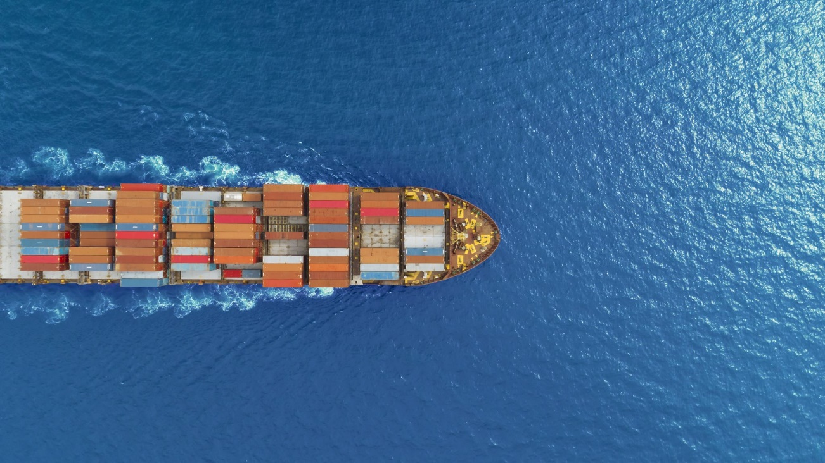
What is a Domestic Transhipment Request (DTR) ?
A Domestic Transhipment Request (DTR) is the electronic process for moving uncleared cargo from one approved facility to another approved facility.
          Currently working well for Airfreight movements - collections of both consolidations & airline direct cargo (not cleared) from the Airlines back to a bond store.

Slide 4

Phase 1 FAK CARGO (including ecom FCLs)
Submitted electronically:
Software system eg, Cargowise, Expedient, Tradewindow or inhouse
TSW online
Please attach: VALID QUARANTINE DECLARATION
DETAILED MANIFEST OF CARGO
BILL OF LADING

Slide 5
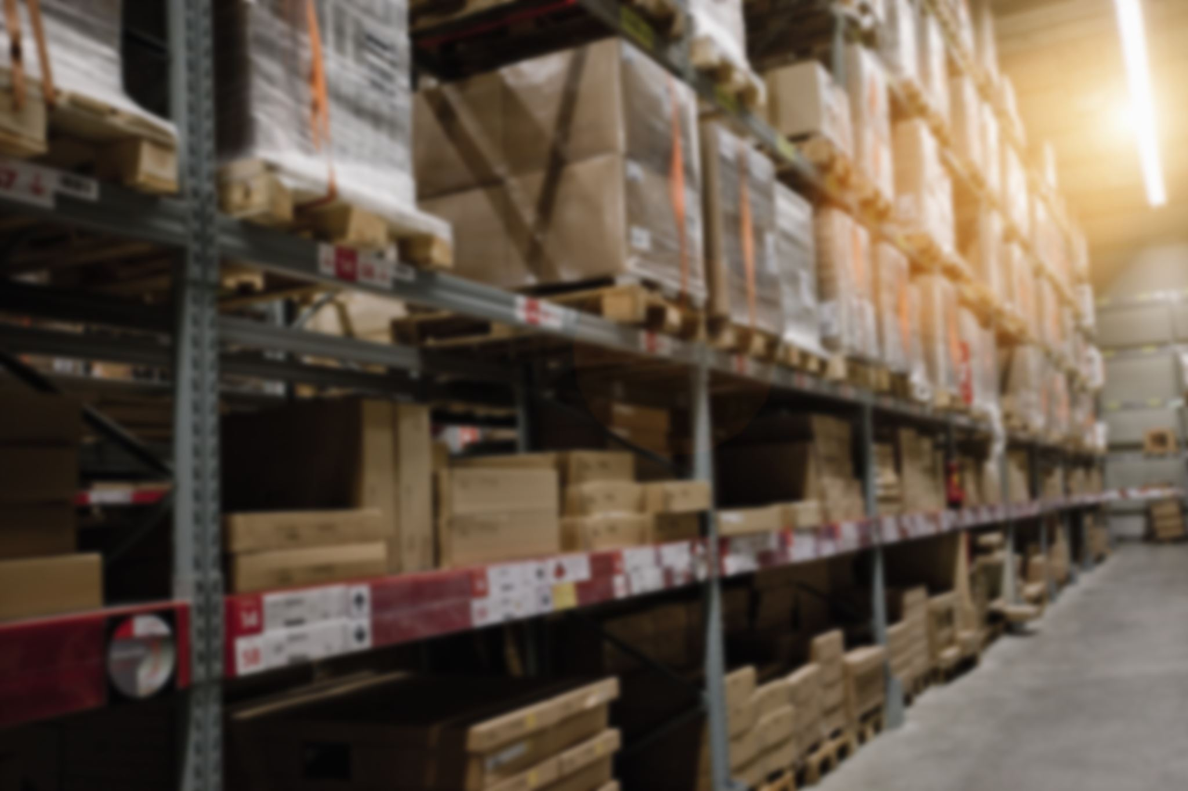
Phase 2 LCL Cargo
Same process as FAK cargo.
Submit a DTR & gain electronic release from MPI & NZ Customs (No mandatory documents required – but helpful if selected for audit )

Slide 6
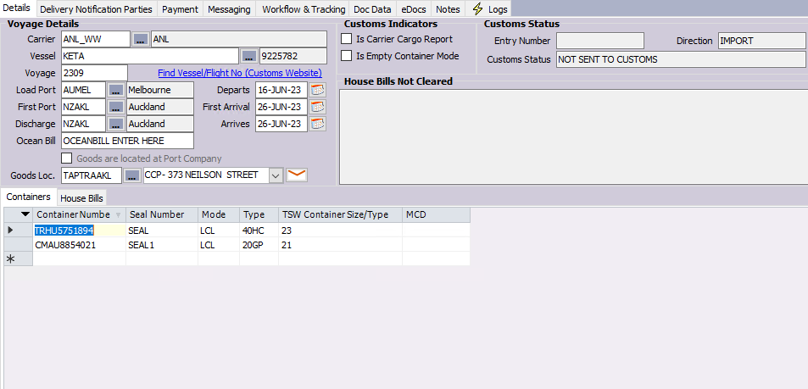

Slide 7
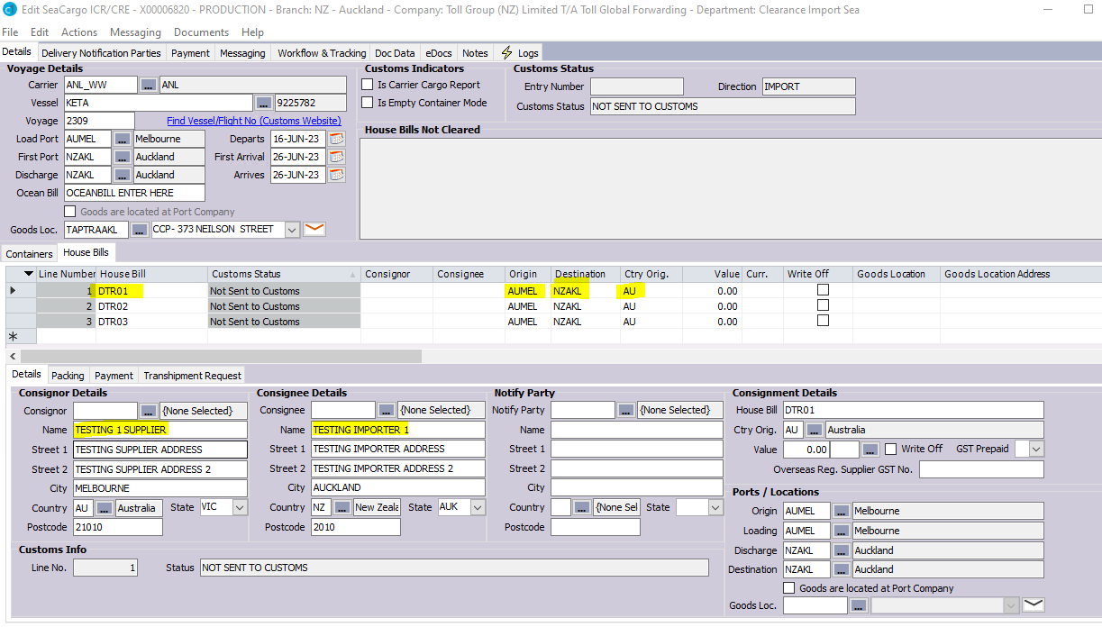

Slide 8
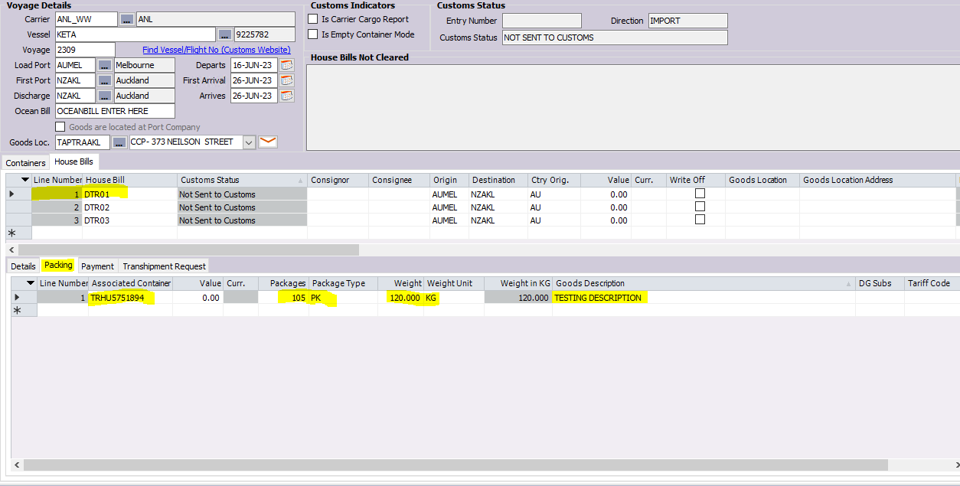

Slide 9
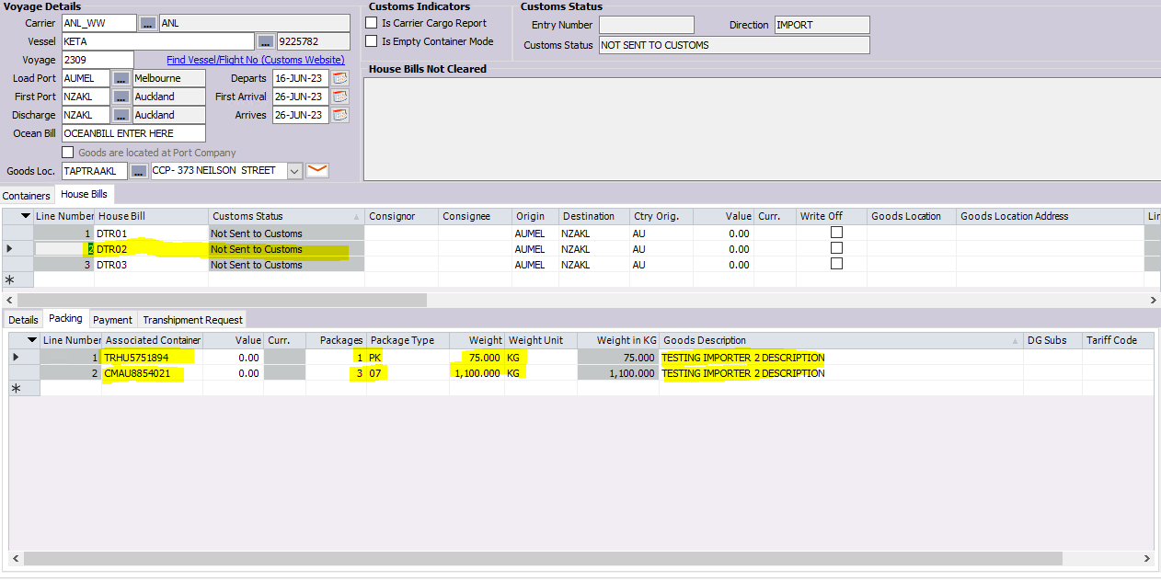

Slide 10
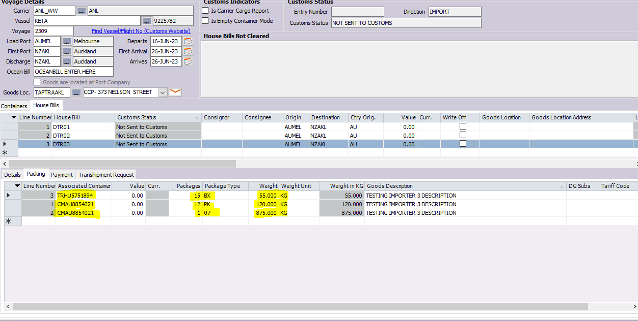

Slide 11
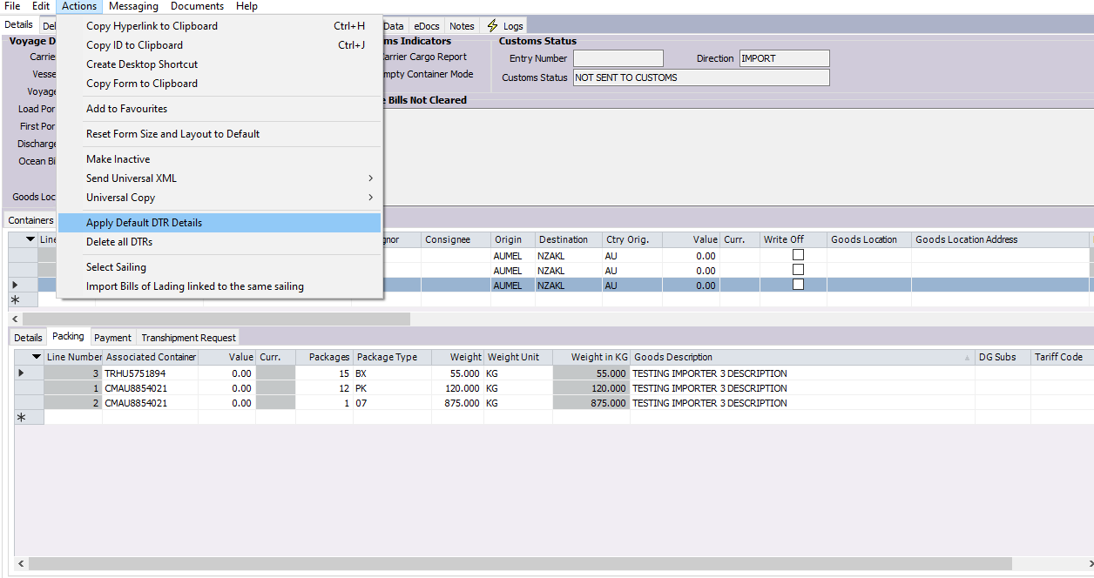

Slide 12
ICR/CRE Accepted, Check Consignments for Status] Response for SeaCargo ICR/CRE: X00006820
Clearance / Acceptance Instructions
---------------------------------------------------------------------
SeaCargo ICR/CRE : X00006820
Entry Number : 23876290
Master Bill : OCEANBILL ENTER HERE
Message No : 257520
Message Status : (B07) MPI Biosecurity Cargo Report Notification - consignment status as specified
Summary : 0 out of 3 Jobs have been Written Off.
Customs Instructions
---------------------------------------------------------------------
MB OCEANBILL ENTER HERE - MOVEMENT APPROVED. All movements approved under a DTR for uncleared goods must be moved by way of an enclosed, secure, leak-proof conveyance, being either within an enclosed vehicle, or within an enclosed container.
Job Responses
---------------------------------------------------------------------
Job Number: X00006820-1 House Bill: DTR01
<<< Response Status: IDR-Import Declaration Required >>>
Job Number: X00006820-2 House Bill: DTR02
<<< Response Status: IDR-Import Declaration Required >>>
Job Number: X00006820-3 House Bill: DTR03
<<< Response Status: IDR-Import Declaration Required >>>

Slide 13
[ICR/CRE Accepted, Check Consignments for Status] Response for SeaCargo ICR/CRE: X00006820
Clearance / Acceptance Instructions
---------------------------------------------------------------------
SeaCargo ICR/CRE : X00006820
Entry Number : 23876290
Master Bill : OCEANBILL ENTER HERE
Message No : 257524
Message Status : (C06) Customs Cargo Report Notification - consignment status as specified
Summary : 0 out of 3 Jobs have been Written Off.
Customs Instructions
---------------------------------------------------------------------
MB OCEANBILL ENTER HERE - MOVEMENT APPROVED
Job Responses
---------------------------------------------------------------------
Job Number: X00006820-1 House Bill: DTR01
<<< Response Status: IDR-Import Declaration Required >>>
Job Number: X00006820-2 House Bill: DTR02
<<< Response Status: IDR-Import Declaration Required >>>
Job Number: X00006820-3 House Bill: DTR03
<<< Response Status: IDR-Import Declaration Required >>>

Slide 14

Don’t delay – start today !
Check your system is set up (most current version)
Check your CCA & ATF codes are correct in your system
If you are an unpacking depot – check your staff understand how to
read the DTR responses
EMAIL DTR@MPI.GOVT.NZ

